Slide 1
BELA MILK PRODUCTION ENTERPRISE
AGRICULTURAL & BIOSYSTEMS ENGINEERING
FARM STRUCTURES
GROUP 2

Slide 2
Content
Introduction
Production
Structures & Equipment
Processing Line or Activity Analysis
Flow of Material
Farmstead Planning

Slide 3
Introduction
Bela milk production enterprise is an enterprise under the production and processing of milk from dairy cattle (livestock).

Slide 4
Production
600 dairy cattle for the milk production
An average weight of an adult dairy cow is about 700 Kg producing about 6 gallons (22 litres) of milk per day.
Therefore an estimate of 3,600 gallons approximately 13,320 litres of milk will be produced daily by the milk house (600 dairy cattle).

Slide 5
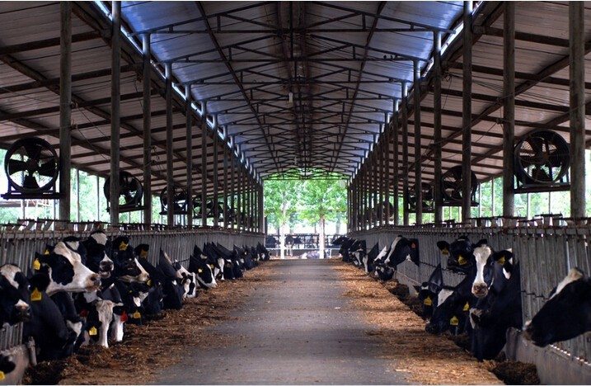
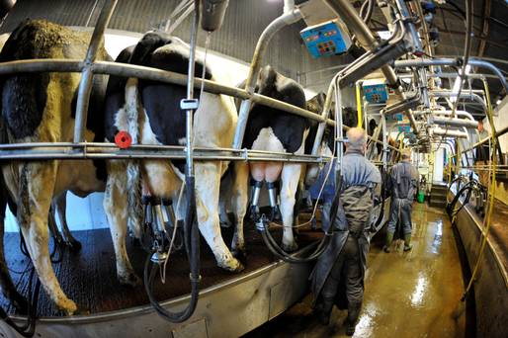
Structures & Equipment
1. Dairy House/ cattle structure 2. Milk Palour & Milking
machine
3. Manure Pit 4. Implement shed

Slide 6
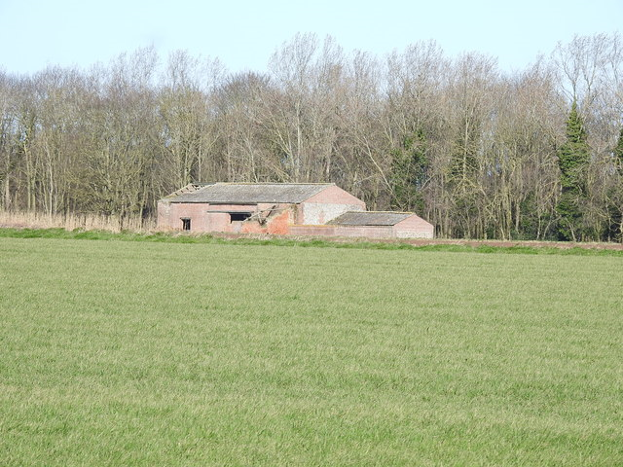
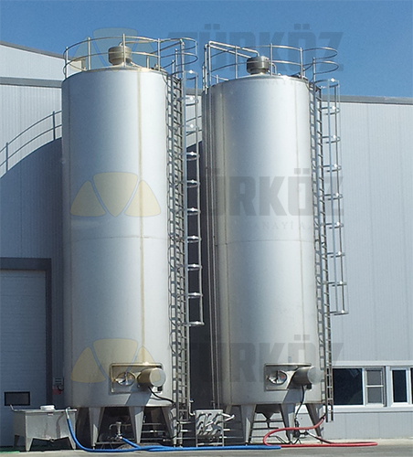
Structures & Equipment Cont’d…
5. Pasture land / grazing field 6. Milking storage
structure or Milk silo
7. Packaging Machinery

Slide 7
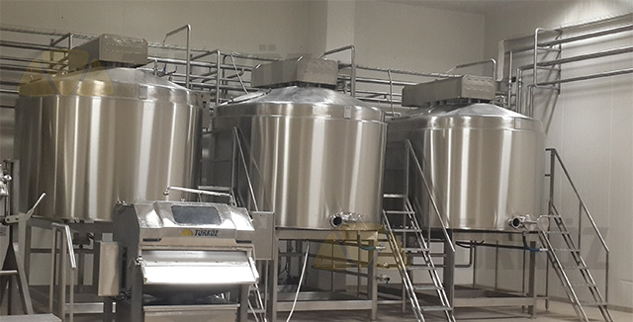
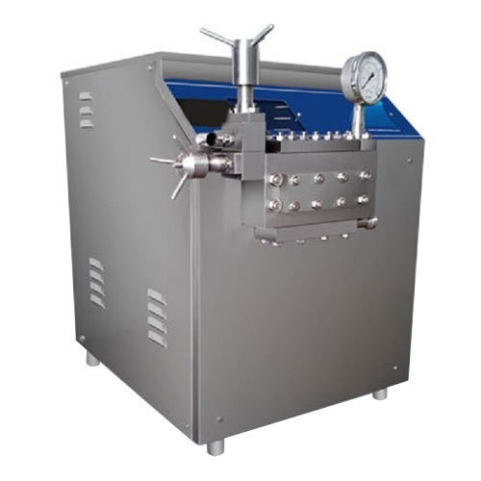
Structures & Equipment Cont’d…
8. Processing Tanks 9. Homogenizer &
Separators
10. Pasteurizer or Pasteurising Plant

Slide 8
Processing Lines or Activity Analysis
Grazing/Feeding
Laboratory & Testing
Milking Reception
Cream Separation
Cold or Warm Storage
Packaging
Product Processing
Vitamin Addition
Pasteurisation
Distribution

Slide 9
Flow of Material
Raw Milk from Cattle
Processing Tank
Filter
Separator
Raw Cream Storage
Homogenizer
Pasteurizer
Packaging Material
Milk Silos
Pasteurized storage
Filler
Distribution

Slide 10
Farmstead Planning
Wind Direction
Road
Z 4
15 – 30 m
N
Z 3
10 – 30 m
Z 2
Z 1

Slide 11
Farmstead Planning Cont’d…
KEY
Z 1 : Farmhouses
Z 2 : Implement shed, Machinery storage area and fuel storage site
Z 3 : Pasture land, feeding storage site and Milk Silos
Z 4 : Dairy house or Cattle structure and Milk processing plant

